Slide 1


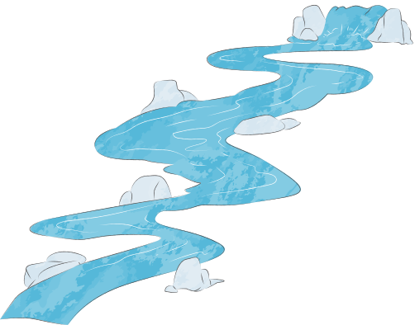
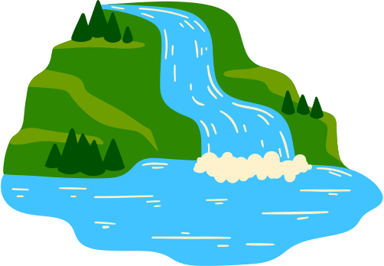
Water Country
Aboriginal and Torres Strait Islander peoples have cared for Country, including rivers and wetlands, for thousands of years. Through this, they have developed deep knowledge of the environment and sustainable water management. Water Country is vital for life, culture, and ecosystems, and listening to Aboriginal voices ensures their perspectives and wisdom are respected and used to guide sustainable practices today.

Slide 2
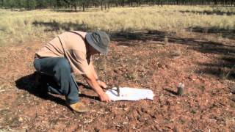
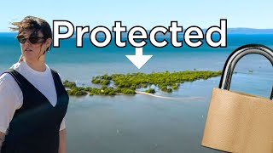
Water Country
Watch the videos and answer the questions on the worksheet.

Slide 3
Water Country
Activity: Design ethical interview questions you can ask local elders or First Nations communities to understand their perspective of water and caring for Country.
Notes:
Worksheet 8.2

